Slide 1
Faculty of Nursing Cairo University
2024-2025
Evaluation course (02808)
2nd Doctoral Semester
GRADING
Prepared by:
Doha Amin Amer
Mohamed Ahmed Adly
Mustafa Mohamed Hussein
Under Supervision of:
Prof .Dr/ Effat ElKarmalawy
Prof .Dr/ Enas Helmy
Assist. Prof/ Heba Ahmed

Slide 2
Objectives.
At the end of this discussion, each candidate should be able to:
Discuss the meaning of grading system.
Differentiate between grading and scoring.
Describe the benefits of grading.
Classify types of grading systems.
Illustrate the grading framework.
Analyze the Principles in evaluating and grading clinical Practice

Slide 3
Outlines.
Introduction
Definition of grading
Benefits of grading system in education
Grades inflation
Types of Grading System
Assigning Letter Grades
Grading Framework Criterion
Referenced
Norm Referenced
Self Referenced
Grading Clinical Practice
Grading Software

Slide 4
Introduction.
The teacher’s assessment of students provides the basis for assigning a grade for the course. The grade is a symbol reflecting the achievement of students in that course. In addition to grading the course as a whole, grades are given for individual assignments, quizzes, tests, and other learning activities completed by students throughout the course. This discussion examines the uses of grades in nursing programs, problems with grading, grading frameworks, and how to compute grades for nursing courses (Oermann&Gaberson 2021)
20XX
4

Slide 5
Definition of grading.
Grading is for summative purposes, indicating through the use of symbols how well the student performed in individual assignments, clinical practice, laboratories, and the course as a whole.
To reflect valid judgments about student achievement, grades need to be based on careful evaluation practices, reliable test results, and multiple assessment methods.
(Oermann&Gaberson 2021)
20XX
5

Slide 6
Grading vs. Scoring
Attribute | Grading | Scoring
Definition | It is the process of assigning a symbol to represent the quality of the student’s performance. | It is the process of determining the first direct, unconverted, un-interpreted measure of performance on a test,
Scale | Symbols can be letters (A, B, C, D, ..) categories (pass fail,satisfactory– unsatisfactory) or percentages | Usually based on numerical/raw values
Conversion process | Grades cannot easily convert to scores | Scores can easily convert to grades
Subjectivity | Can be influenced by the instructor's interpretation of the work | Less subjective as it is based on predetermined criteria

Slide 7
The benefits of grading system in education.
1-Assessment of Learning: Grades provide a measurable way to evaluate a student's understanding and mastery of the material. They help educators identify areas where students excel or struggle.
2-Motivation: Grades can motivate students to engage with their studies, strive for improvement, and set academic goals. High grades may encourage students to continue their efforts, while low grades can prompt them to seek help or change their study habits.

Slide 8
The benefits of grading system in education.Cont.,
3-Feedback: A grading system offers feedback to students about their performance. This feedback can help them understand their strengths and weaknesses, guiding their learning process.
4-Standardization: Grades create a standardized way to compare student performance across different schools, classes, and educational systems. This can help maintain academic integrity and fairness.

Slide 9
The benefits of grading system in education.Cont.,
5-Accountability: Grades hold both students and educators accountable. Students are responsible for their learning, while teachers are motivated to ensure that their instruction leads to student success.
6-Progress Tracking: Grades allow for tracking a student’s progress over time. This can help educators and parents identify trends in learning and development.

Slide 10
The benefits of grading system in education.Cont.,
7-Informed Decision-Making: Grades provide valuable data for school administrators and policymakers to make informed decisions about curriculum, teaching methods, and resource allocation.
8-Preparation for Future Challenges: The grading system prepares students for future academic and professional environments where performance evaluations are common, teaching them to handle feedback and work toward improvement.

Slide 11
Grades Inflation
Grades are inflated and thus do not reflect true achievement.
It is the awarding of higher grades than students deserve.
denotes an increase in grade point average without an increase in achievement.
Generally, grade inflation means students are given higher grade that do not corresponds to the levels of their mastery; either because the teacher has low expectations or to keep the school's reputation intact.
Example: Giving students Excellent while their actual achievement equal Good not Excellent.

Slide 12
Grades Inflation.Cont.,
Example:
At a prestigious university, the average GPA of graduating seniors in 1990 was 2.8 (on a 4.0 scale). Over the next 30 years, without a corresponding increase in student performance metrics (like standardized test scores or time spent studying), the average GPA rose to 3.5 by 2020.

Slide 13
Grades Inflation.Cont.,
Example. Cont.,Despite this increase in GPA, professors and academic studies noted that:
The difficulty of coursework remained the same or even decreased.
More students were receiving A's and B's, even for average or below-average performance.
Grades were being awarded more generously, often to avoid complaints or boost student evaluations.
As a result, a B in 1990 might reflect stronger academic performance than an A in 2020, making it harder to distinguish between truly exceptional students and average ones.

Slide 14
Grades Inflation.Cont.,
Factors contributing to grade inflation:
Students are paying more for their education, and they want a reward of high grades for their “purchase.”
Faculty hesitancy in assigning lower grades and not recognizing the problem with grade inflation.
A close relationship of the teacher with students especially in clinical teaching, resulting in educators being more lenient in their grades.
a lack of precision in tools used for evaluation.
(Oermann&Gaberson 2021)

Slide 15
Grades Inflation.Cont., Methods to overcome grade inflation.
In developing a grading system, it is important for nurse educators to be clear about the standards for each grade level in that system and to communicate these to students.
Faculty should periodically review the grades in nursing courses to assess whether they are inflated,

Slide 16
Grades Inflation.Cont., Methods to overcome grade inflation.
Instructor Training Program on Fair Student Assessment
Mandatory workshops on fair grading practices should be initiated. Senior faculty who have good reputation in giving fair grades should mentor new instructors. This will help to enhance teaching effectiveness and to reduce faculty defensiveness during their evaluations.

Slide 17
Grades Inflation.Cont., Methods to overcome grade inflation.
Inform the Students about Grading Policies
These statements of standards should be in their course syllabus to guide students toward what they are expected to accomplish and also to evaluate their work. Discussing grading policies and standards will help restore fair grading practices. The discussion will help the students to have realistic expectations about what grades they deserve based on their performances.

Slide 18
Grades Inflation.Cont., Methods to overcome grade inflation.
Regular Meetings to Discuss Grading Trends by Administration and Faculty
Providing feedback to the faculty members on their teaching effectiveness and student assessment. Giving accountability and justification to each faculty for the grades they are giving will discourage members from practicing grade inflation.

Slide 19
Grades Inflation.Cont., Methods to overcome grade inflation.
Use of the Quota System
Limiting the number of high grades that can be awarded to their students in a particular class is another way to combat grade inflation.

Slide 20
Grades Inflation.Cont., Methods to overcome grade inflation.
Instituting Objective Exams
Objective grading criteria tends to reduce the effect of grading subjectivity. objective exams provide a generally unbiased measurement to compare the effectiveness of instructors.

Slide 21
Types of grading systems.
Letter System (A,B,C,D,E or A,B,C,D,F)
Use of Integers (5,4,3,2,1 or 9 – 1)
Percentage Based System
Two-dimensional (pass-fail, satisfactory-unsatisfactory, credit-no credit, met-not met)
Grade Point Average

Slide 22
Types of grading systems.Cont.,
Letter System :
Letter grades follow a five-point system, using the letters A, B, C, D and E/F which may also be combined with “+” and “-” with A indicating excellent, C indicating average and E/F indicating failing.
Use of Integers
It uses numbers 5,4,3,2,1 or 9 – 1. Helps make grades more accurate reflections of what students have learned and accomplished in school.

Slide 23
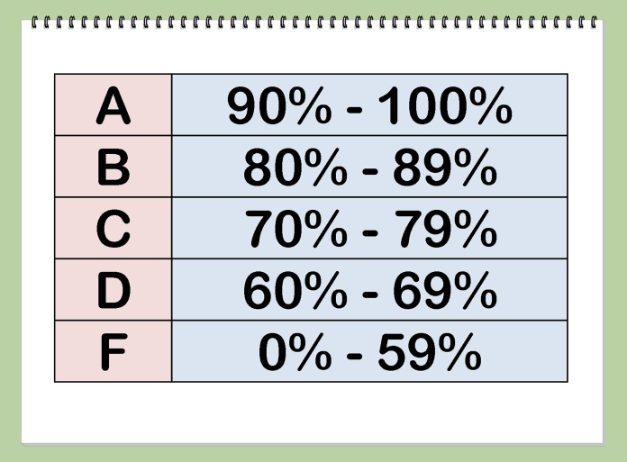
Types of grading systems.Cont.,
Percentage Based System:
Uses a 100% scale to grade student performance. Each assignment is assigned 100%. The sum of all the categories is 100. Used as basis in assigning letter grades.
Two-dimensional
Pass/fail courses operates on a binary grading system. Students receive either a passing grade or a failing grade satisfactory–unsatisfactory, or credit–no credit. No letter grade will be recorded on transcript of records.
The grade is not calculated in the GPA

Slide 24
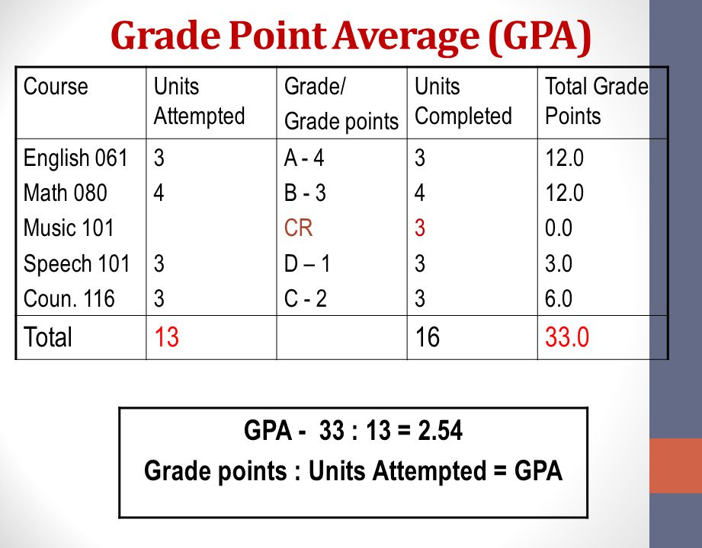
Types of grading systems.Cont.,
Grade Point Average
Involves converting the letter grade to a grade point system to calculate the GPA or QPA (quality point average).
Example of a grade in a 4-point system:
A = 4 points per credit/unit
B = 3 points per credit/unit
C = 2 points per credit/unit
D = 1 point per credit/unit
E/F = 0 point per credit/unit

Slide 25
Types of grading systems.Cont.,
Example If a student took two 3-credit courses and ONE 6-credit nursing course and received an A in one of the 3-credit courses, a C in the other, and a B in a 6-credit course, Calculate GPA?
A student takes:
Two 3-credit courses
One 6-credit course (a nursing course)
And receives:
A in one 3-credit course → 4 points × 3 credits = 12 grade points
C in the other 3-credit course → 2 points × 3 credits = 6 grade points
B in the 6-credit course → 3 points × 6 credits = 18 grade points
Now, to calculate GPA:Total Grade Points = 12 + 6 + 18 = 36
Total Credits Attempted = 3 + 3 + 6 = 12
GPA = Total Grade Points ÷ Total Credits = 36 ÷ 12 = 3.0

Slide 26
PLUS AND MINUS SYSTEM
Letter Grade | Grade Points
A | 4.00
A- | 3.67
B+ | 3.33
B | 3.00
B- | 2.67
C+ | 2.33
C | 2.00
C- | 1.67
D+ | 1.33
D | 1.00
D- | 0.67
F | 0.00

Slide 27
ASSIGNING LETTER GRADES
Two major considerations in assigning letter grades :
Deciding What to include in the grade (tests, projects, classwork, etc.)
Selecting a grading framework (criterion referenced, norm referenced, self referenced)
•Deciding what to include in the grade
Grades should reflect students achievement rather than teacher’s own values, beliefs and attitudes. It should be based on the tests and assessment method developed for the course. Multiple components should be considered to determine course grades.
•
23

Slide 28
Assigning letter grades cont.,
Factors to consider when weighting components of the course grades :
Components that assess more of the important learning outcomes and competencies
Components that assess content that is emphasized in the course and for which more time was spent
Components that measure the application of knowledge and skills to clinical practice
Components that are more difficult and time-consuming

Slide 29
SELECTING A GRADING FRAMEWORK
Three types of grading framework or frame of reference:
1) Criterion-Reference
2) Norm-Referenced Grading
3) Self-referenced
20XX
Pitch Deck
29

Slide 30
Selecting a grading framework cont.,
1) Criterion-Reference or grading with an absolute scale
On-referenced grading, grades are based on students’ achievement of the outcomes of the course, the extent of content learned in the course, or how well they performed in clinical practice.
Rating or grading a student based on criteria or objectives (fixed standard)
This framework is appropriate for most nursing courses because they focus on outcomes and competencies to be achieved in the course.
Indicates how students are progressing in meeting those outcomes (formative evaluation) and whether they have achieved them at the end of the course (summative evaluation)

Slide 31
Selecting a grading framework cont.,
Methods of assigning grades using a criterion referenced system :
1. Fixed percentage method
Uses fixed ranges of percent-correct score as the basis for assigning grades
A percentage-correct score or percentage of the total points possible are given to each component of the course grade (written tests, case presentation and others)
•

Slide 32
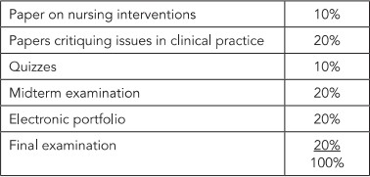
Selecting a grading framework cont.,
Computing a Composite (Single) Score for a Course
Percentage Score is assigned in each components, for example :

Slide 33
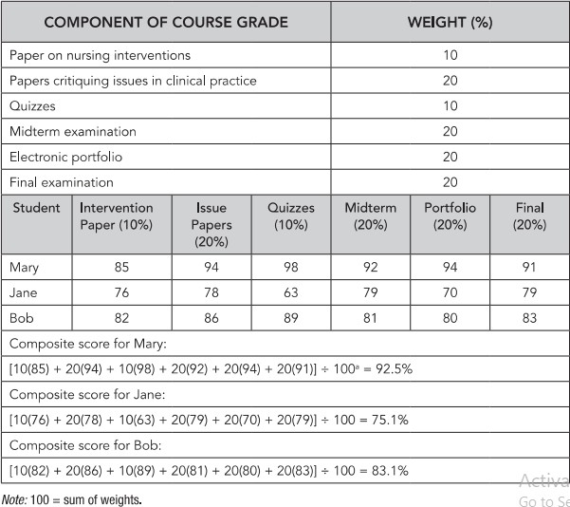
Selecting a grading framework cont.,.
Computing a Composite (Single) Score for a Course
Fixed Percentage Method for Grading Nursing Course

Slide 34
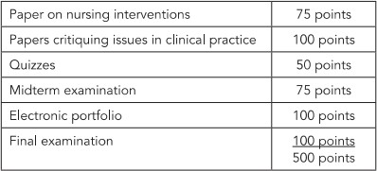
Selecting a grading framework cont.,
2. Total Points Method
The second method of assigning grades in a criterion-referenced system is the total-points method. In this method, Specific number of points is assigned per component
For Example:
29

Slide 35
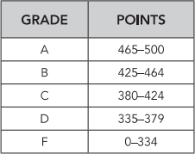
Selecting a grading framework cont.,
Total Points Method The points for each components are not converted to letter grade; the grades are assigned based on the accumulated points at the end of the course. Letter grade are assigned based on accumulated points.
For example:

Slide 36
Selecting a grading framework cont.,
2) Norm-Referenced Grading
By use of relative standards, grades are assigned by comparing a student’s performance by that of others in the class. The teacher decides on the reference group against which to compare a student’s performance.
Norm-referenced grading, in contrast, is not appropriate for use in nursing courses that are based on standards or learning outcomes because it focuses on comparing students with one another, not on how they are progressing or on their achievement.

Slide 37
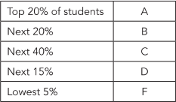
Selecting a grading framework cont.,
Two methods of assigning grades using a norm-referenced system
1) Grading on the curve or score distribution curve
Scores are ranked from highest to lowest and grades are assigned according to the rank order.
Using this method, there will always be a failing grades on a test. Grades are assigned without considering the actual achievements. The teachers determine the proportion of grades at each level – not based on normal curve.
For Example:

Slide 38
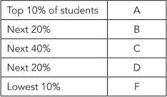
Selecting a grading framework cont.,
Normal or Bell Curve
Grades in the course should have normal distribution.
For Example:

Slide 39
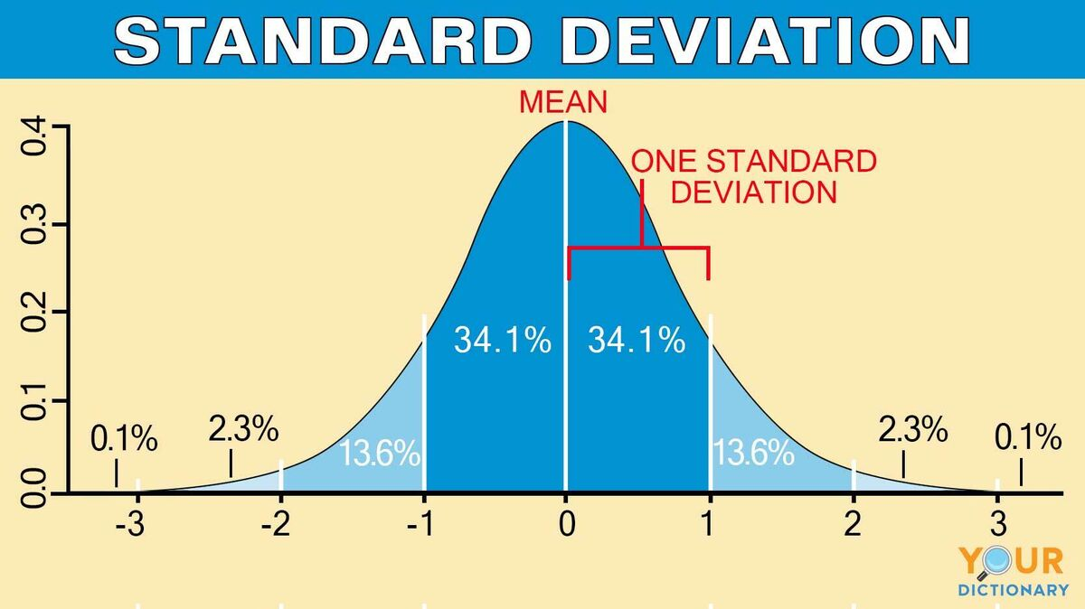
Selecting a grading framework cont.,
Two methods of assigning grades using a norm-referenced system
2) Standard Deviation Method
The teachers determines the cutoff points for each grade. In using this method, mean score should be calculated. With this method, the teacher has a reference point (mean) and the average distance from the mean (Miller et al., 2013).Grade boundaries are based on standard deviation.

Slide 40
Selecting a grading framework cont.,
3) Self-Referenced Grading
Self-referenced grading is based on standards of growth and change in the student. With this method, grades are assigned by comparing the student’s performance with the teacher’s perceptions of the student’s capabilities
Did the student achieve at a higher level than deemed capable regardless of the knowledge and competencies acquired?
Did the student improve performance throughout the course?

Slide 41
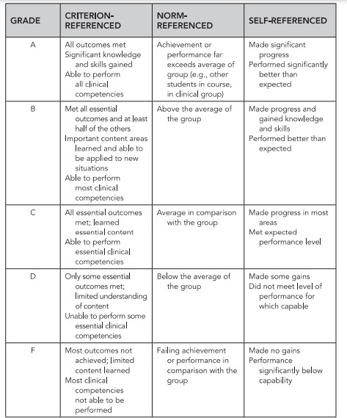
Comparison of Grading Frameworks

Slide 42
Grading clinical practice
Grading systems for clinical practice may include using letter grades, A-F; integers 5-1; percentage, and two-dimensional (pass-fail, satisfactory- unsatisfactory, met–not met).
Two criteria to be met in grading system in clinical practice:
evaluation methods in collecting data (summative evaluation)
understanding of the students on how clinical practice maybe evaluated and graded (grading framework)

Slide 43
Grading clinical practice cont.
Categories for grading clinical practice
Pass-Fail (two-dimensional)
Requires only two types of judgment
Advantages:
Often easier for the teacher than using the same evaluation information for deciding on multiple levels of performance.
Allows teachers to give continuous feedback to learners
Disadvantage:
The inability to include a clinical grade in the course grade

Slide 44
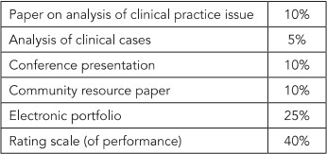
Grading clinical practice cont.
Evaluation Method
Source of data for the grade.
For Example:
In above table, clinical grade is computed based on evaluation method. Summative evaluation method were incorporated into the grades
40

Slide 45
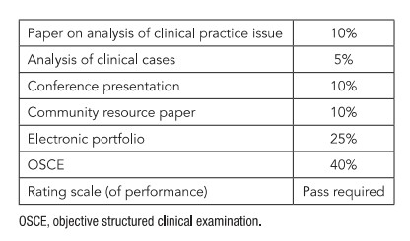
Grading clinical practice cont.
If pass-fail to be incorporated in evaluation method, the grade maybe computed as illustrated below:
NOTE: Students should always be aware of how the evaluation and grading will be carried out.
41

Slide 46
Grading clinical practice cont.
Principles that should be followed in evaluating and grading clinical Practice:
1) Communicate Evaluation and Grading in Writing
The manner in which the students will be graded and evaluated should be documented in writing and communicated to all.
2) Identify Effect of Failing Clinical Practicum in Course Grade
The effect should be clearly stated in the course syllabus and policies.
Sample policy statement in a pass-fail clinical grading:

Slide 47
Principles in evaluating and grading clinical Practice cont.,
In a letter-grade system, the policy should include the letter grade representing a failure.
Sample policy statement in a letter - grade system:
3) Ask Students To Sign Notes, Rating Forms, And Evaluation Summaries
Signed documents by students does not mean they agreed but it means they read and know. They should also be given the rights to write their own comments.

Slide 48
Principles in evaluating and grading clinical Practice cont.,
4) Identify Performance Problems Early And Develop Learning Contracts
Continuous feedback on student’s clinical performance should always be observed. Performance data should be discussed openly.
If problems with regards to performance and clinical deficiencies that may affect passing the course are identified, an open discussion should be held to be able to develop a plan that can correct deficiencies.

Slide 49
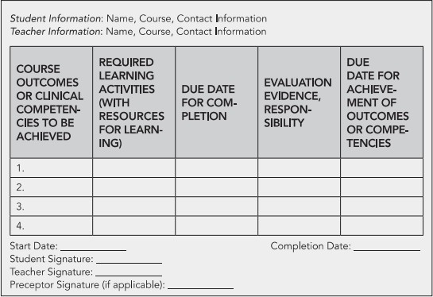
Principles in evaluating and grading clinical Practice cont.,
Below is sample of developed plan for students :
Note: Discussion to a failing student should be held in private and a summary of the discussion should be prepared.

Slide 50
Principles in evaluating and grading clinical Practice cont.,
5) Identify Support Services
Failing students should be referred to counselling and other support services to
avoid biases that can influence judgement of the student’s clinical performance.
6) Document Performance
Teacher should continue to give feedback and to guide learning. Documentation of the observation made, other evaluation data collected and the learning activities completed by the students.
Teachers should not observed and document the performance ONLY of those at risk for failing to avoid misunderstanding that the student is treated differently.

Slide 51
Principles in evaluating and grading clinical Practice cont.,
7) Follow Policy On Unsafe Clinical Performance
Policy with regards to unsafe clinical practice of the students should be implemented. Students who demonstrates safe care can continue in clinical course because outcomes are measured at the end of the course and not during it.
8) Follow Policy for Failure of a Clinical Course
It is important that all teachers know the policies and procedures to be implemented for students who failed the clinical course.

Slide 52
Grading software
Spreadsheet application like Microsoft Excel makes the grading system easier. With his application, a teacher can enter individual scores, weight of each component and compute final grades.
Learning Management system gives way for the teachers to manage all aspects of students grades. The learners will have online access to their own grades.

Slide 53
References
Oermann, M. H., &Gaberson, K. B. 6th ed (2021). Evaluation and testing in nursing education. Springer Publishing Company.
Nilson, L. B., & Stanny, C. J. (2023). Specifications grading: Restoring rigor, motivating students, and saving faculty time. Routledge .
Onesi-Ozigagun, O., Ololade, Y. J., Eyo-Udo, N. L., & Ogundipe, D. O. (2024). Revolutionizing education through AI: a comprehensive review of enhancing learning experiences. International Journal of Applied Research in Social Sciences, 6(4), 589-607.‏

